Slide 1
Image Coloring using Autoencoders
Transfer Learning

Slide 2
Agenda
Image Colorization
Autoencoders
Dataset Overview
Transfer Learning
VGG-16

Slide 3
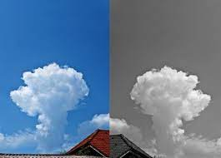
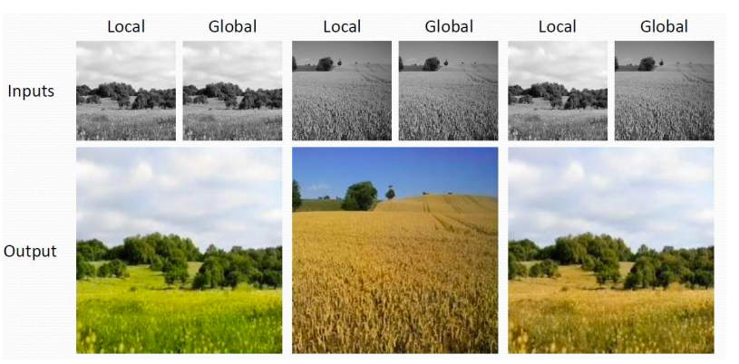
Image Colorization
Image colorization is the process of taking an input grayscale (black and white) image and then producing an output colorized image that represents the semantic colors and tones of the input.
Image colorization assigns a color to each pixel of a target grayscale image
Traditional colorization techniques requires significant user interaction.
In this process, a fully automated data-driven approach “autoencoders” is used for colorization
This method requires neither pre-processing nor post-processing.

Slide 4
Image Colorization Application
Medical Microscope
Medical Imagery
Denoising and recreating old Images
Night Vision Cameras
Survillance

Slide 5
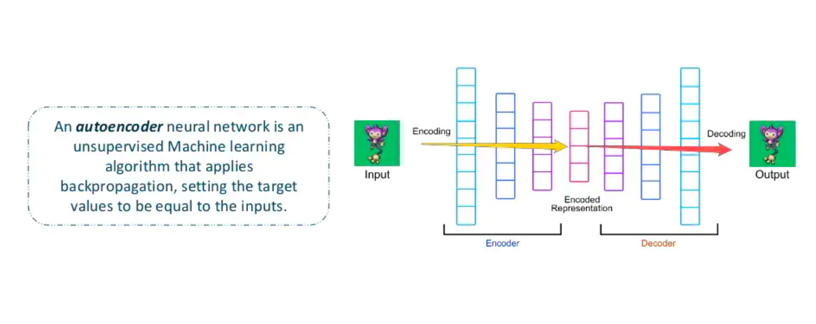
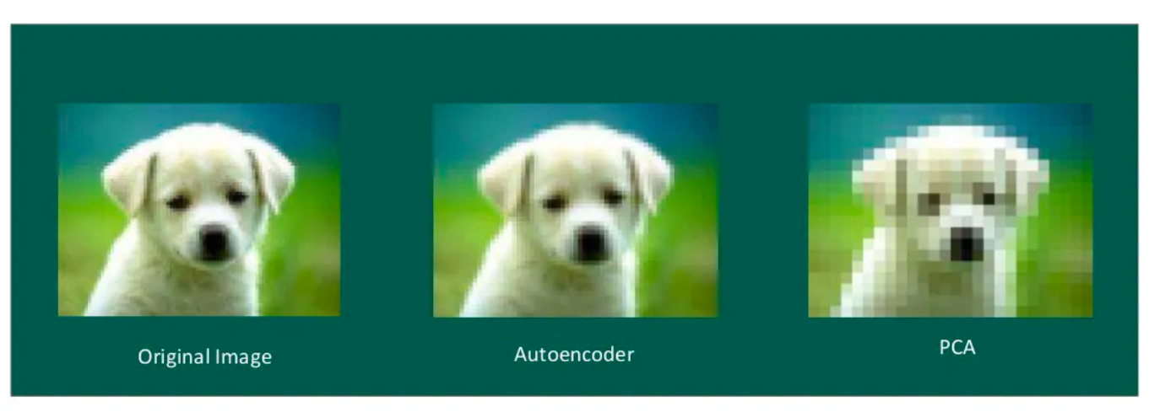
Autoencoders

Slide 6
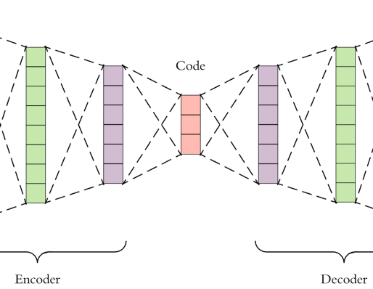
Autoencoders
Autoencoders are a specific type of feedforward neural networks where the input is the same as the output.
An autoencoder neural network is an Unsupervised Machine learning algorithm that applies backpropagation, setting the target values to be equal to the inputs.
They compress the input into a lower-dimensional code(Encoding) and then reconstruct the output from this representation (Decoding).
To build an autoencoder we need 3 things: an encoding method, decoding method, and a loss function to compare the output with the target

Slide 7
Autoencoders
Encoder-Decoder as a very general framework/architecture design. In this design, We have some function that maps an input space to a different/latent space (the “encoder”). The decoder is simply the complementary function that creates a map from the (encoder’s) latent space to another target space (what is it we want to decode from the latent space).
However, an autoencoder is a special case of an encoder-decoder architecture .
In this, the target is the same as the input : X = model.predict(X)
It is not predicting the future but simply reconstructing the present given a state/memory . Autoencoder is doing auto-association, which means that the model learns how to “recall” an input .

Slide 8
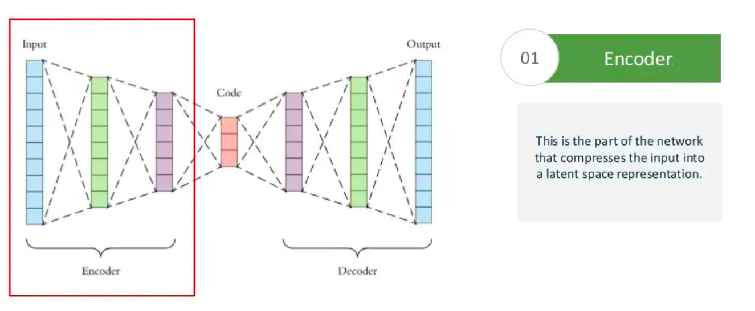
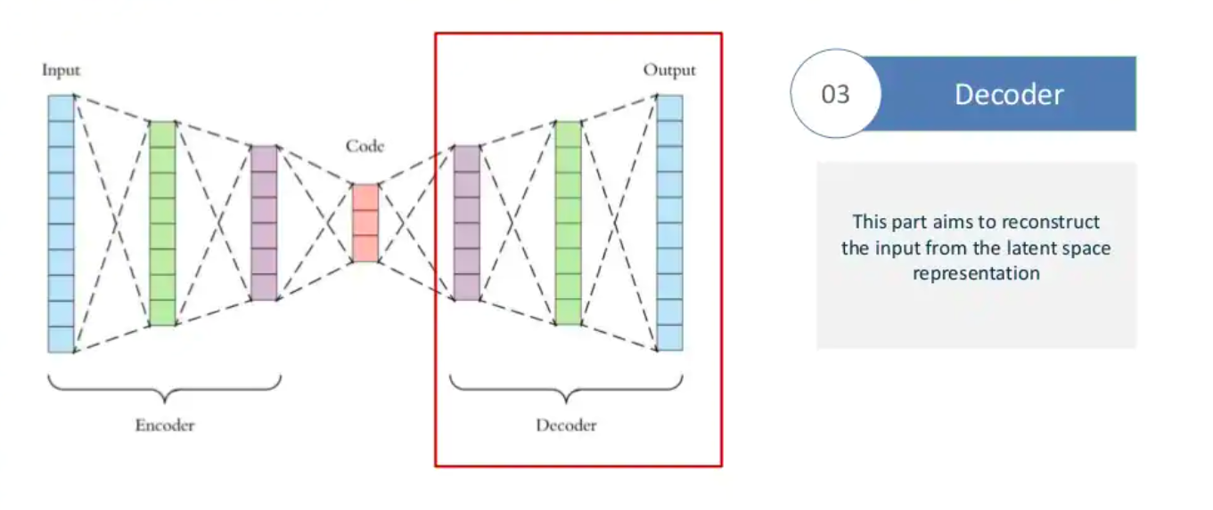
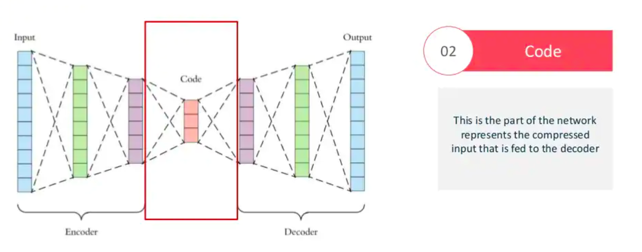
Autoencoders Architecture

Slide 9
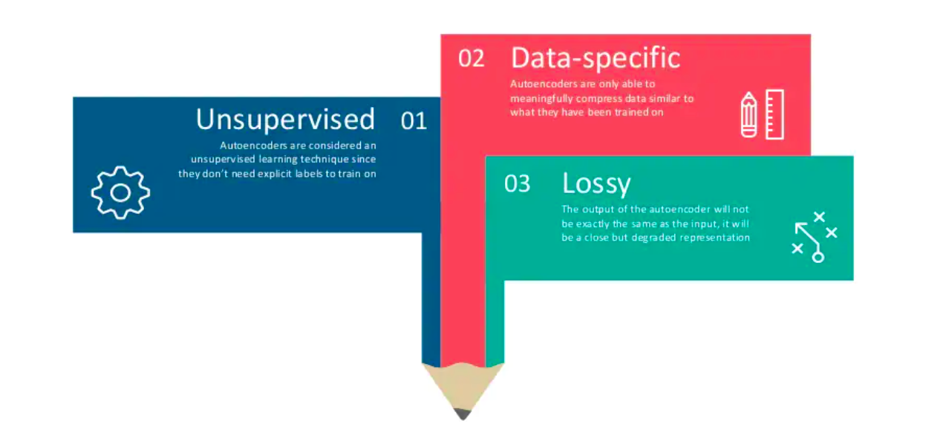
Features

Slide 10
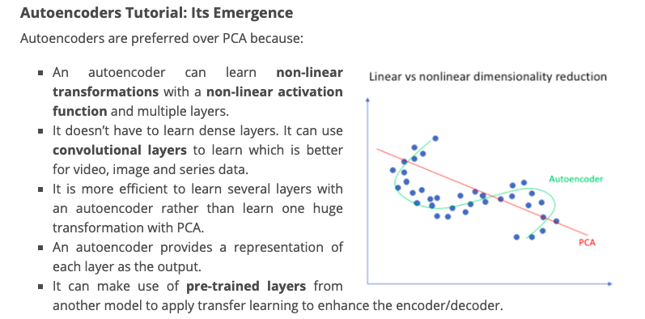

Slide 11
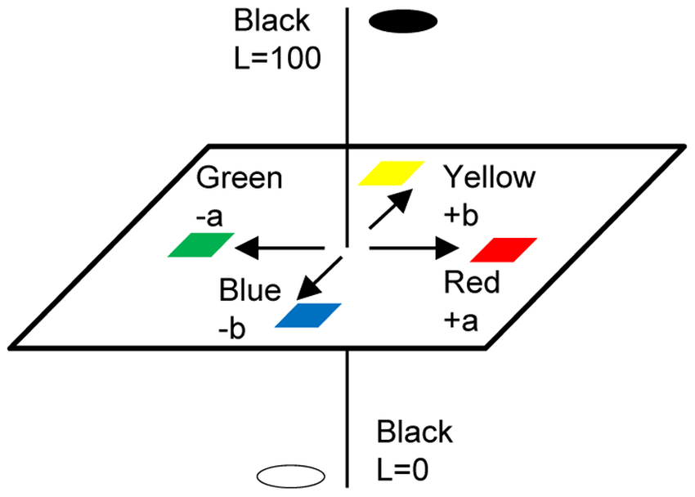
The Data Set Overview
In this Model, Colored Input Images(Landscape Dataset) used.
These Images are decomposed using Lab model and used as an input feature (“L”) and classification labels (“a” and “b”).
For simplicity let’s split in two: “L” and “a+b” as shown in the block diagram.
Having the trained model , we can use it to colorize Black and White Test Images.

Slide 12
Transfer Learning
Humans have an inherent ability to transfer knowledge across tasks. What we acquire as knowledge while learning about one task, we utilize in the same way to solve related tasks. The more related the tasks, the easier it is for us to transfer, or cross-utilize our knowledge. Some simple examples would be,
Know how to ride a motorbike ⮫ Learn how to ride a car
Know how to play classic piano ⮫ Learn how to play jazz piano
Know math and statistics ⮫ Learn machine learning
Transfer learning is a machine learning method where a model developed for a task is reused as the starting point for a model on a second task.
It is a popular approach in deep learning where pre-trained models are used as the starting point on computer vision and natural language processing tasks given the vast compute and time resources required to develop neural network models on these problems and from the huge jumps in skill that they provide on related problems.

Slide 13
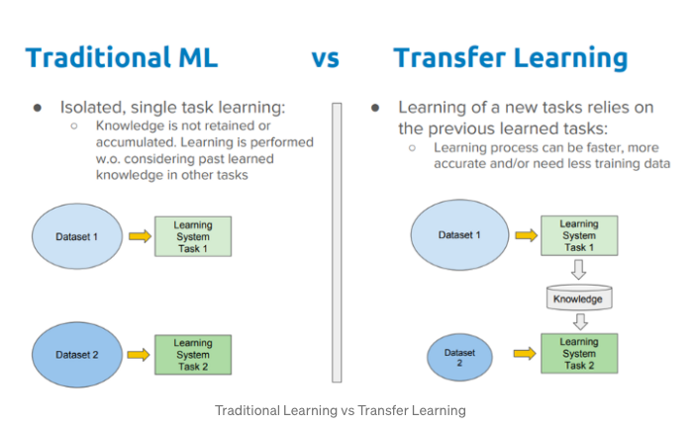
Transfer Learning (Cont.)
Transfer learning, as we have seen so far, is having the ability to utilize existing knowledge from the source learner in the target task. During the process of transfer learning, the following three important questions must be answered:
What to transfer: This is the first and the most important step in the whole process. We try to seek answers about which part of the knowledge can be transferred from the source to the target in order to improve the performance of the target task. When trying to answer this question, we try to identify which portion of knowledge is source-specific and what is common between the source and the target.
When to transfer: There can be scenarios where transferring knowledge for the sake of it may make matters worse than improving anything (also known as negative transfer). We should aim at utilizing transfer learning to improve target task performance/results and not degrade them. We need to be careful about when to transfer and when not to.
How to transfer: Once the what and when have been answered, we can proceed towards identifying ways of actually transferring the knowledge across domains/tasks. This involves changes to existing algorithms and different techniques, which we will cover in later sections of this article. Also, specific case studies are lined up in the end for a better understanding of how to transfer.

Slide 14
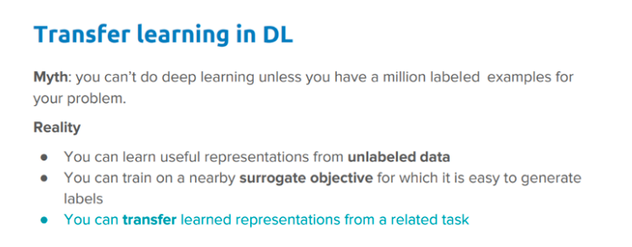
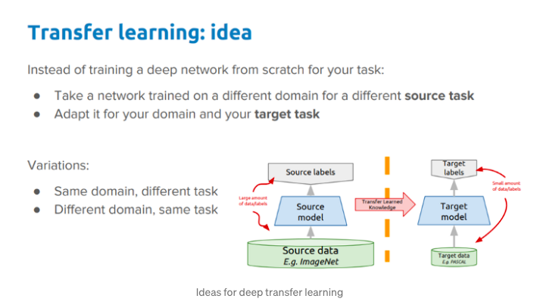
Transfer Learning (Cont.)

Slide 15
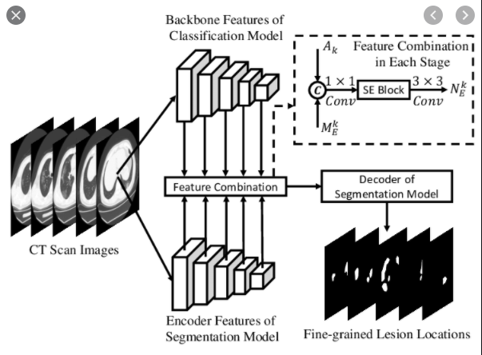
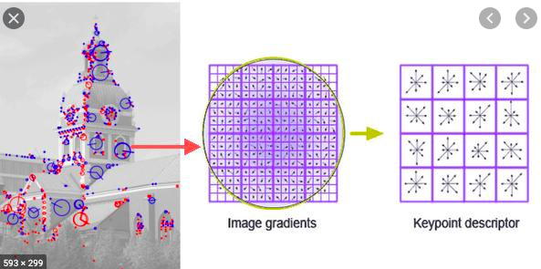
Backbone
Backbone is a term used in models/papers to refer to the feature extractor network.
This is a standard convolutional neural network (typically, VGG16 or VGG19) that serves as a feature extractor. The early layers detect low level features (edges and corners), and later layers successively detect higher level features (car, person, sky).
Backbone gives you a feature map representation of input
Multiple pre trained model used as a backbone for a variety of tasks
VGG16, is a classic neural network used as a backbone for many computer vision tasks

Slide 16
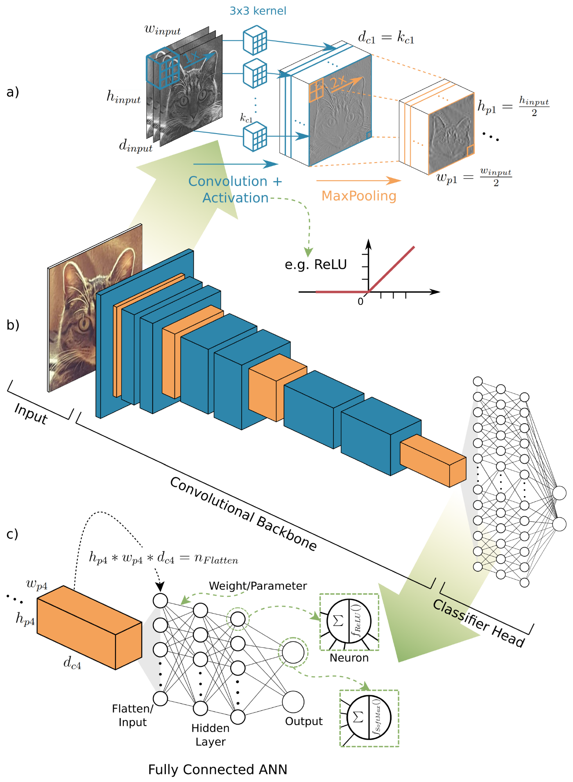
Autoencoders with Backbone

Slide 17
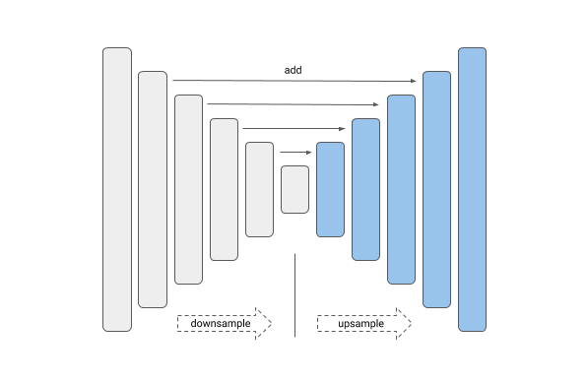
Autoencoders with VGG16

Slide 18

VGG-16 Model Backbone
VGG16 is a convolution neural net (CNN) architecture Visual Geometry Group from Oxford, who developed it.
It follows this arrangement of convolution and max pool layers consistently throughout the whole architecture. In the end it has 2 FC(fully connected layers) followed by a softmax for output.
The network has 41 layers. There are 16 layers with learnable weights: 13 convolutional layers, and 3 fully connected layers.
The 16 in VGG16 refers to it has 16 layers that have weights. This network is a pretty large network, and it has about 138 million (approx) parameters.

